Slide 1
Modulation and Demodulation

Slide 2
What is the reason of the modulation ?
We transmit the signal over long distance.
For a transmission media, there is a bandwidth for signals to be transmitted in the high-frequency range.
By modulation operation, a low-frequency signal can be transformed to a high-frequency signal.
By demodulation operation, the desired low-frequency signal can be extracted in the receiving end.

Slide 3
Modulation and Demodulation of Analog Signal

Slide 4
Types of modulation of analog signals
Amplitude modulation
Frequency modulation
Phase modulation
Pulse amplitude modulation

Slide 5
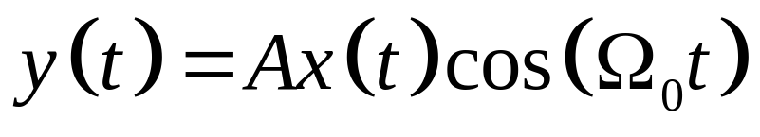
Amplitude modulation(1/6)
Time domain presentation
The amplitude of a modulated signal (high- frequency sinusoidal signal) is varied by the modulating signal (low frequency bandlimited signal)
Carrier signal
Modulated signal
Modulating signal

Slide 6


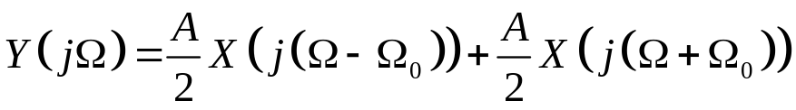

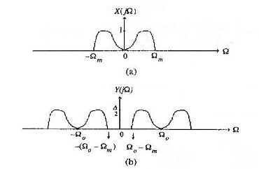
Amplitude modulation(2/6)
Frequency domain presentation
From the properties of the continuous-time Fourier transform, the spectrum of can be given by:
(a) Spectrum of modulating signal (b) Spectrum of the modulated signal

Slide 7
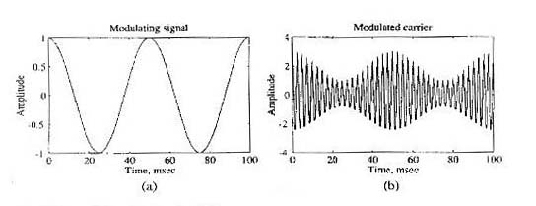
Amplitude modulation(3/6)
Double sideband suppressed carrier modulation (DSB-SC)
The absence of a carrier component
Simple double sideband modulation (DSB)
The carrier is present in the modulated signal
(a) a sinusoidal modulating signal (b) modulated signal based on DSB modulation

Slide 8
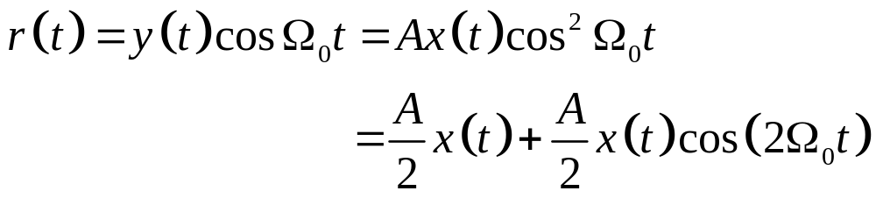
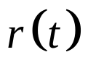


Amplitude modulation(4/6)
Demodulation
  The product of modulated signal with a sinusoidal signal of the same frequency as the carrier
  The orignal modulating signal can be recovered from by passing it through a lowpass filter with a cutoff frequency

Slide 9
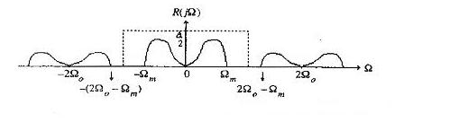
Amplitude modulation(5/6)
Spectrum of the product of the modulated signal and the carrier

Slide 10
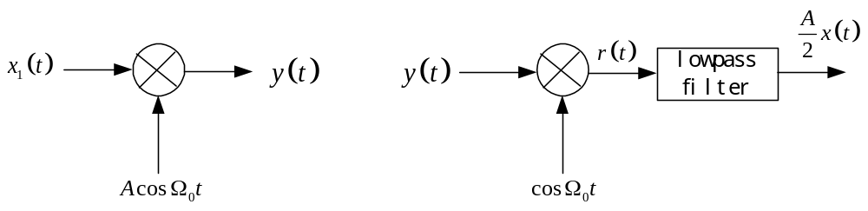
Amplitude modulation(6/6)
Schematic representations of the amplitude modulation and demodulation
Modulation
Demodulation
Schematic representation of amplitude modulation and demodulation

Slide 11
Quadrature Amplitude Modulation(1/3)
Quadrature amplitude modulation (QAM) method
Using DSB modulation to modulate two different signals so that they both occupy the same bandwidth and improve the modulation efficiency.
In-phase component
quadrature
component
Spectrum of the modulated signal

Slide 12
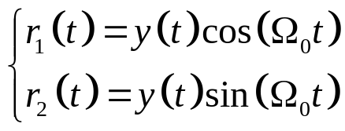
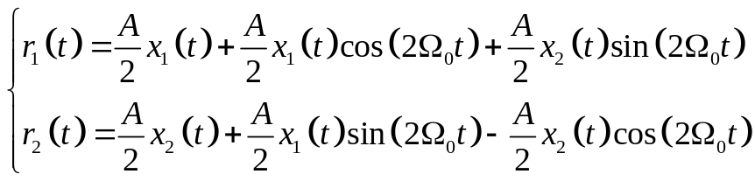
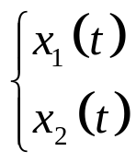
Quadrature Amplitude Modulation(2/3)
Demodulation
Low-pass filter

Slide 13
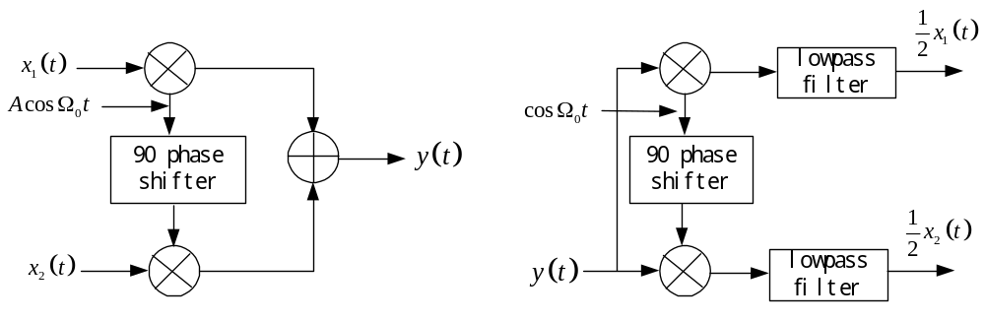
Quadrature Amplitude Modulation(3/3)
Schematic representation of QAM
Modulation
Demodulation
Schematic representation of QAM

Slide 14
Modulation and Demodulation of Digital Signal

Slide 15
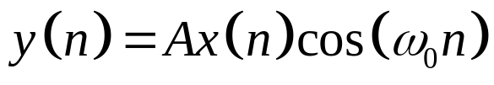
Digital Modulation and Demodulation(1/6)
Time domain presentation
The amplitude of a modulated signal (high- frequency sinusoidal signal) is varied by the modulating signal (low frequency bandlimited signal)
Modulated signal
Carrier signal
Modulating signal

Slide 16


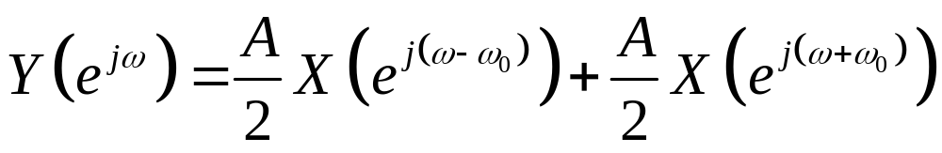


Digital Modulation and Demodulation(2/6)
Frequency domain presentation
From the properties of the discrete-time Fourier transform, the spectrum of can be given by:
where, is the spectrum of

Slide 17
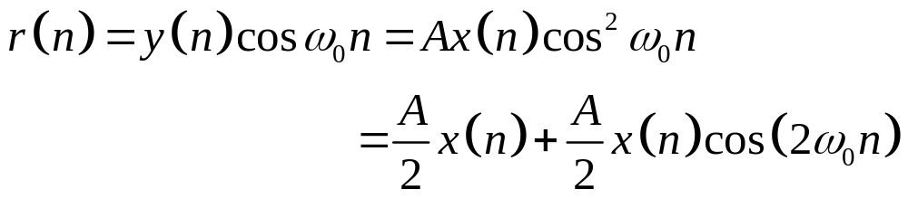


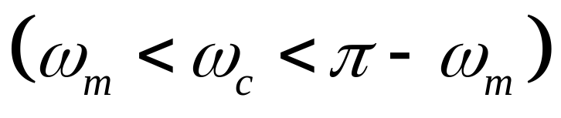
Digital Modulation and Demodulation(3/6)
Demodulation
  The product of modulated signal with a sinusoidal signal of the same frequency as the carrier
  The orignal modulating signal can be recovered from by passing it through a lowpass filter with a cutoff frequency

Slide 18
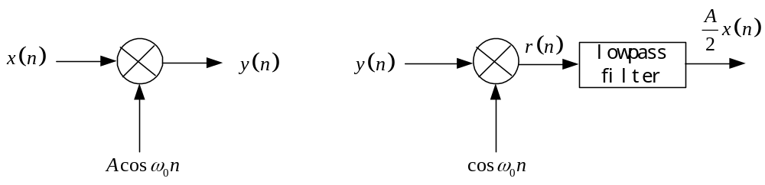
Digital Modulation and Demodulation(4/6)
Schematic representations of the amplitude modulation and demodulation
Modulation
Demodulation
Schematic representation of amplitude modulation and demodulation

Slide 19
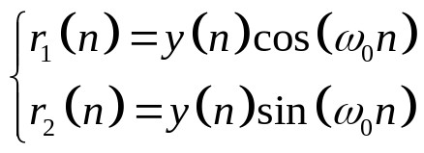
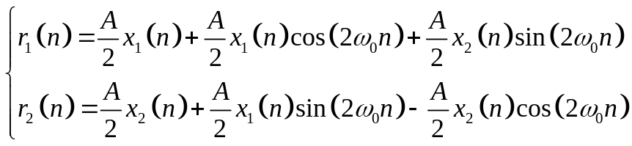
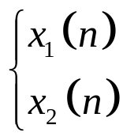
Quadrature Amplitude Modulation(2/3)
Demodulation
Low-pass filter

